Slide 1

HEAL United: Empowering K–12 Health and Physical Education
Practical strategies and resources to strengthen student wellness through the HEAL Curriculum.
Notes:
Introductions

Slide 2

The History of HEAL United
HEAL (Healthy Eating Active Living)
Founded in 2002
  Founded by Christy Swaid after retiring from professional racing
  Alabama based 501(c)(3) nonprofit
  Created in response to rising childhood obesity rates
  Built as an in-school, evidence-based health curriculum
  Early collaboration with Alabama Departments of Public Health and Education
Notes:
HEAL began as a kitchen table conversation, shaped by the growing realization that Alabama’s children were facing rising rates of obesity and chronic disease. This was not an abstract headline.
In 2002, Christy Swaid, a six-time world champion Jet Ski racer, stepped away from professional competition, relocated to Alabama, and began asking how she can make an impact in Alabama.
Her career had not been a straight climb. After several difficult losses, she realized something had to change. Instead of pushing harder and overtraining, she began training smarter. Using heart rate monitoring technology, she focused on working within her healthy heart zone. That shift in approach helped her regain strength, endurance, and eventually return to the top of the podium.
That experience changed more than her training plan. It reshaped how she thought about performance and health.
If this approach could restore a champion athlete, why could those same principles not help children build lifelong health?
That question became the foundation of HEAL.
From the start, this was never about hosting a one time event or giving a motivational talk that would fade by the next week. The goal was to create a structured, evidence based curriculum that could live inside schools. Something teachers could use. Something students could practice. Something that would become part of the culture, not just a moment.
Early partnerships with the Alabama Department of Education and Blue Cross and Blue Shield of Alabama gave the work credibility and stability. Those relationships helped shape the model and ensured it was grounded in real educational practice.
The vision was straightforward then, and it remains the same today: teach children healthy habits in a way that stays with them long after they leave the classroom.

Slide 3
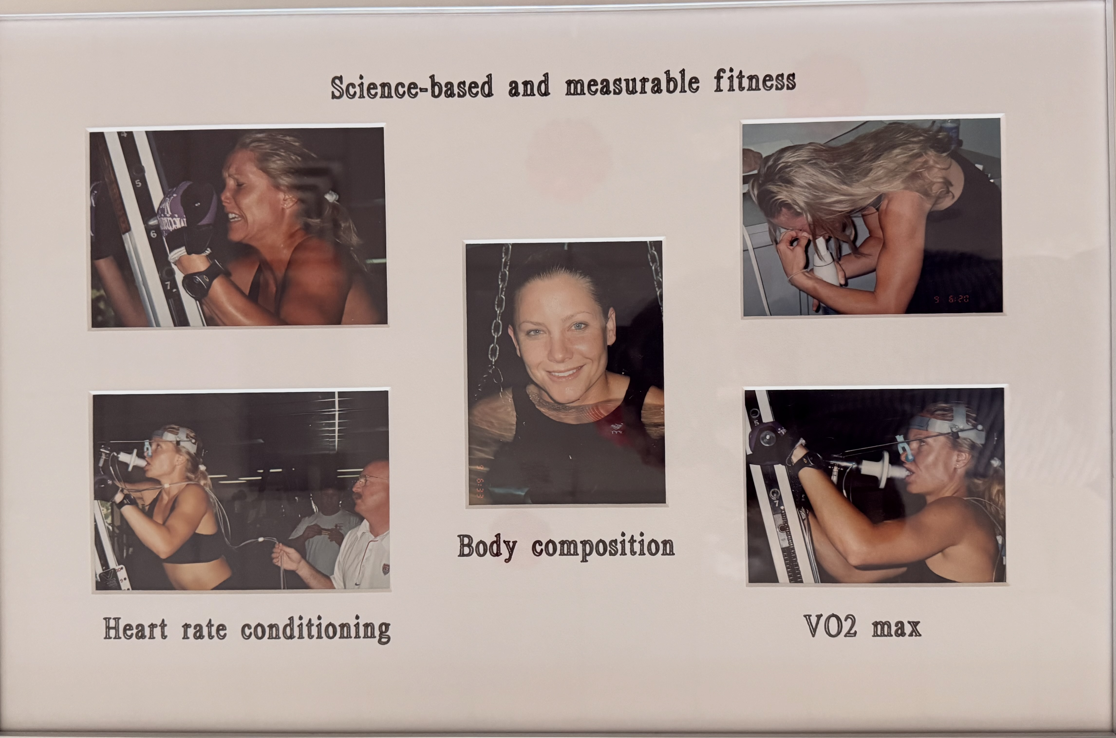
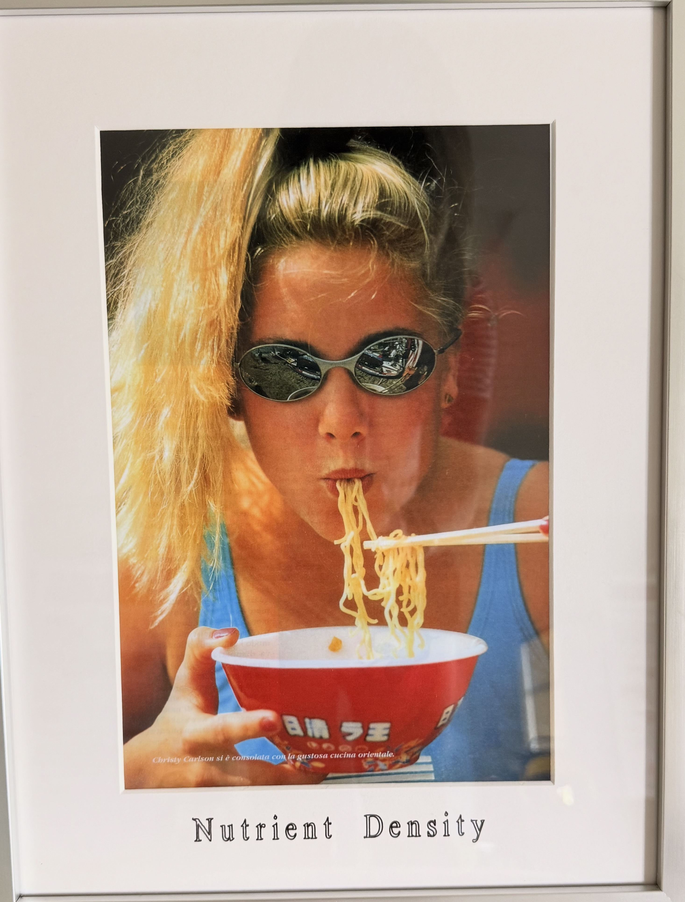
Christy Swaid, Founder, CEO

Slide 4
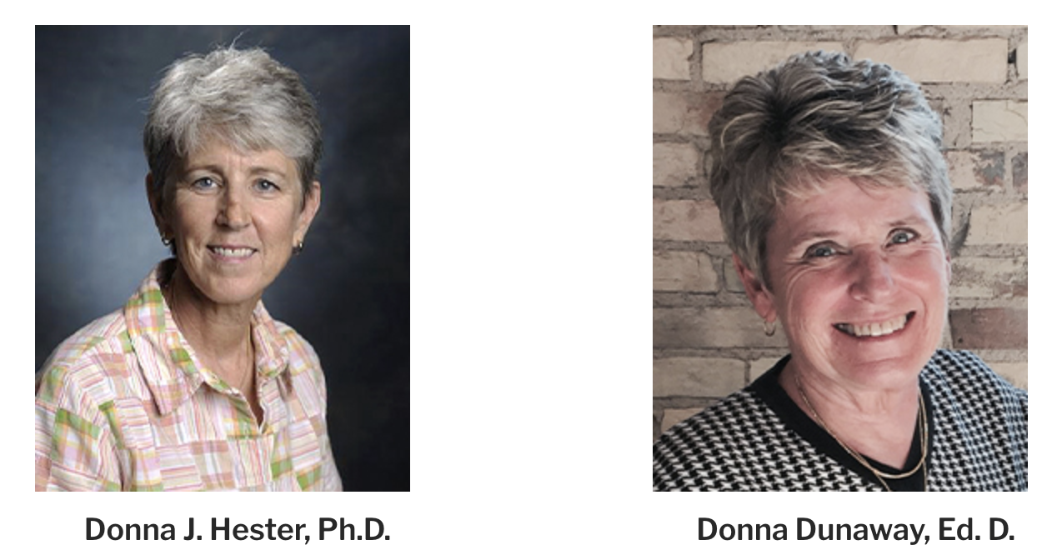
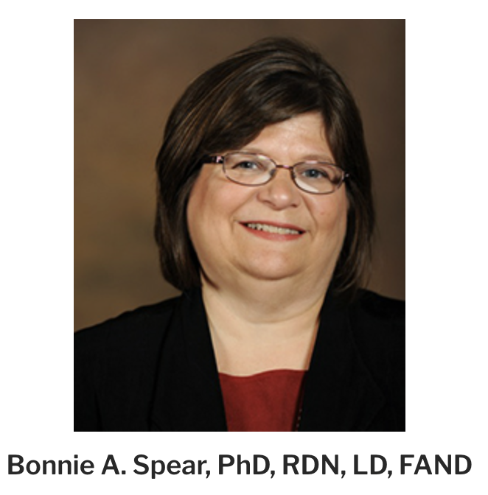
Original
Curriculum Architects
Instructionally solid, Standards-aligned, and Sustainable inside schools.
Notes:
Talking Points
HEAL focuses on practical instruction that students can use immediately.
The curriculum covers nutrition, cooking skills, movement, and overall wellness.
HEAL Day became a visible reminder that health, literacy, and leadership matter in our schools.
What began as one woman’s concern became a structured system schools could implement year after year.
The mission has not changed. But the reach has. Here is where HEAL stands today.

Slide 5
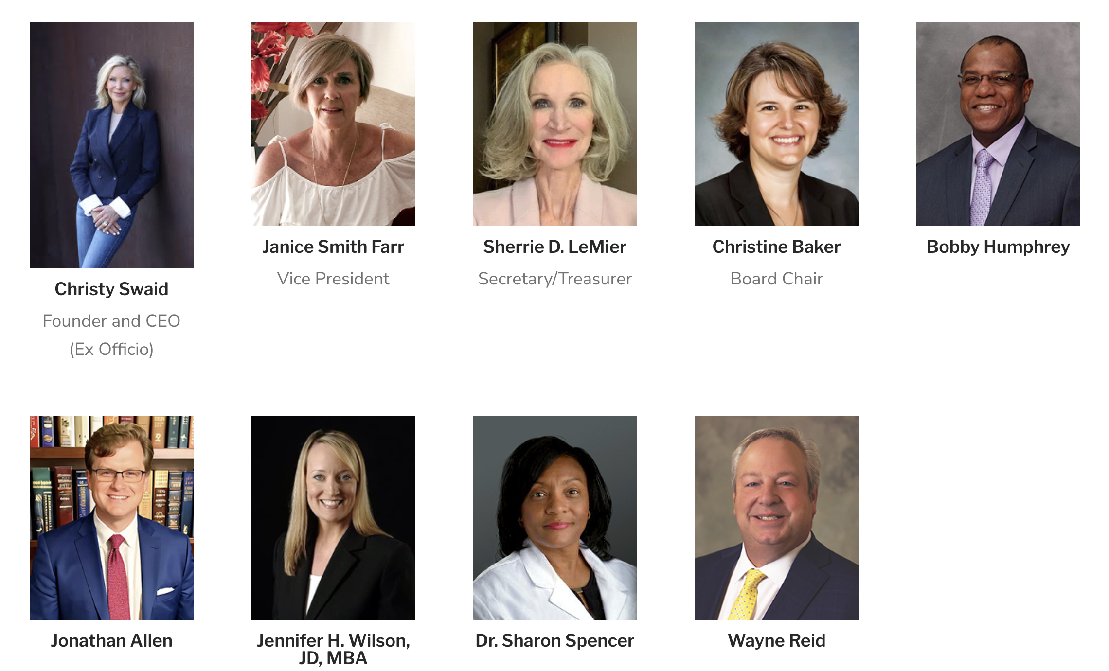
Our Board of Directors – Expertise and Lived Experience
Missioned-focused, financially responsible, and positioned for long-term growth
Notes:
Talking Points
HEAL focuses on practical instruction that students can use immediately.
The curriculum covers nutrition, cooking skills, movement, and overall wellness.
HEAL Day became a visible reminder that health, literacy, and leadership matter in our schools.
What began as one woman’s concern became a structured system schools could implement year after year.
The mission has not changed. But the reach has. Here is where HEAL stands today.

Slide 6
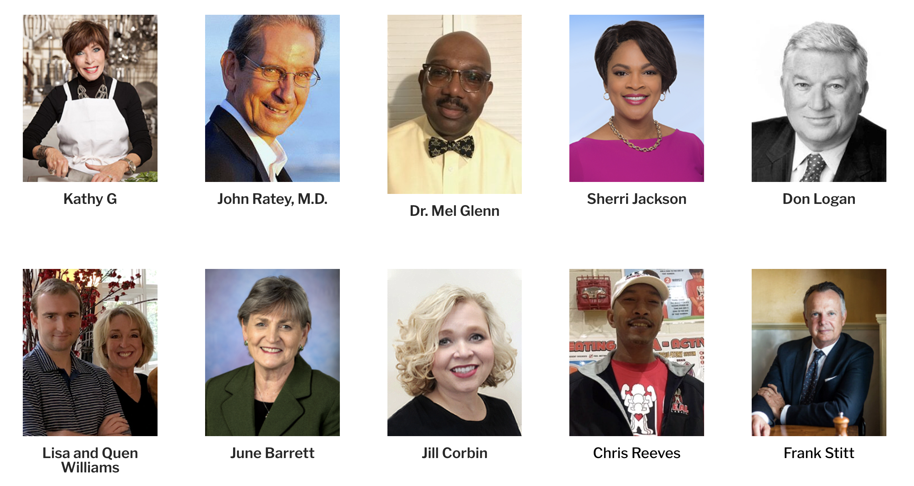
Our Advisory Board – Represents Diverse Perspectives
Grounded in science, practical application, and real-world insight.

Slide 7
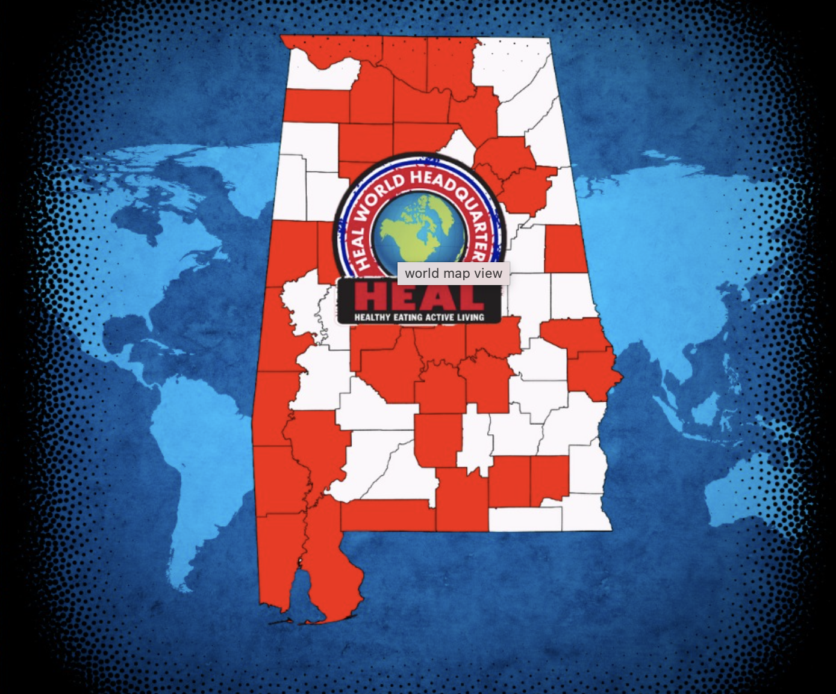
HEAL United’s Current Alabama Footprint
217 Alabama K–12 Schools
60 School Systems
39 Counties
44,000+ Students
Over 75% Title I Schools
Higher Education & Extended Reach
• Faulkner University
• Jefferson State Community College
• Samford University
• University of Alabama at Birmingham, University of South Alabama
• Harding University
• Missionary Educators in Africa
HEAL is reaching communities where health disparities are greatest.
Notes:
Today, HEAL is active in 217 K–12 schools across Alabama.
We are serving 60 school systems in 39 counties, which gives us both rural and urban reach.
More than 44,000 students are currently impacted.
Over 75 percent of our partner schools are Title I, which means we are working in communities where health disparities are often the greatest.
HEAL is not limited to K–12. We also partner with institutions like Faulkner University, Jefferson State Community College, Samford University, and the University of Alabama at Birmingham to support training, leadership development, and expanded impact.
Our reach has even extended beyond Alabama through partnerships such as Harding University and Missionary Educators in Africa.
What began as a local response has become a statewide movement with growing national and international connections.
Numbers matter. But what matters more is what happens in the schools where HEAL is in place.

Slide 8
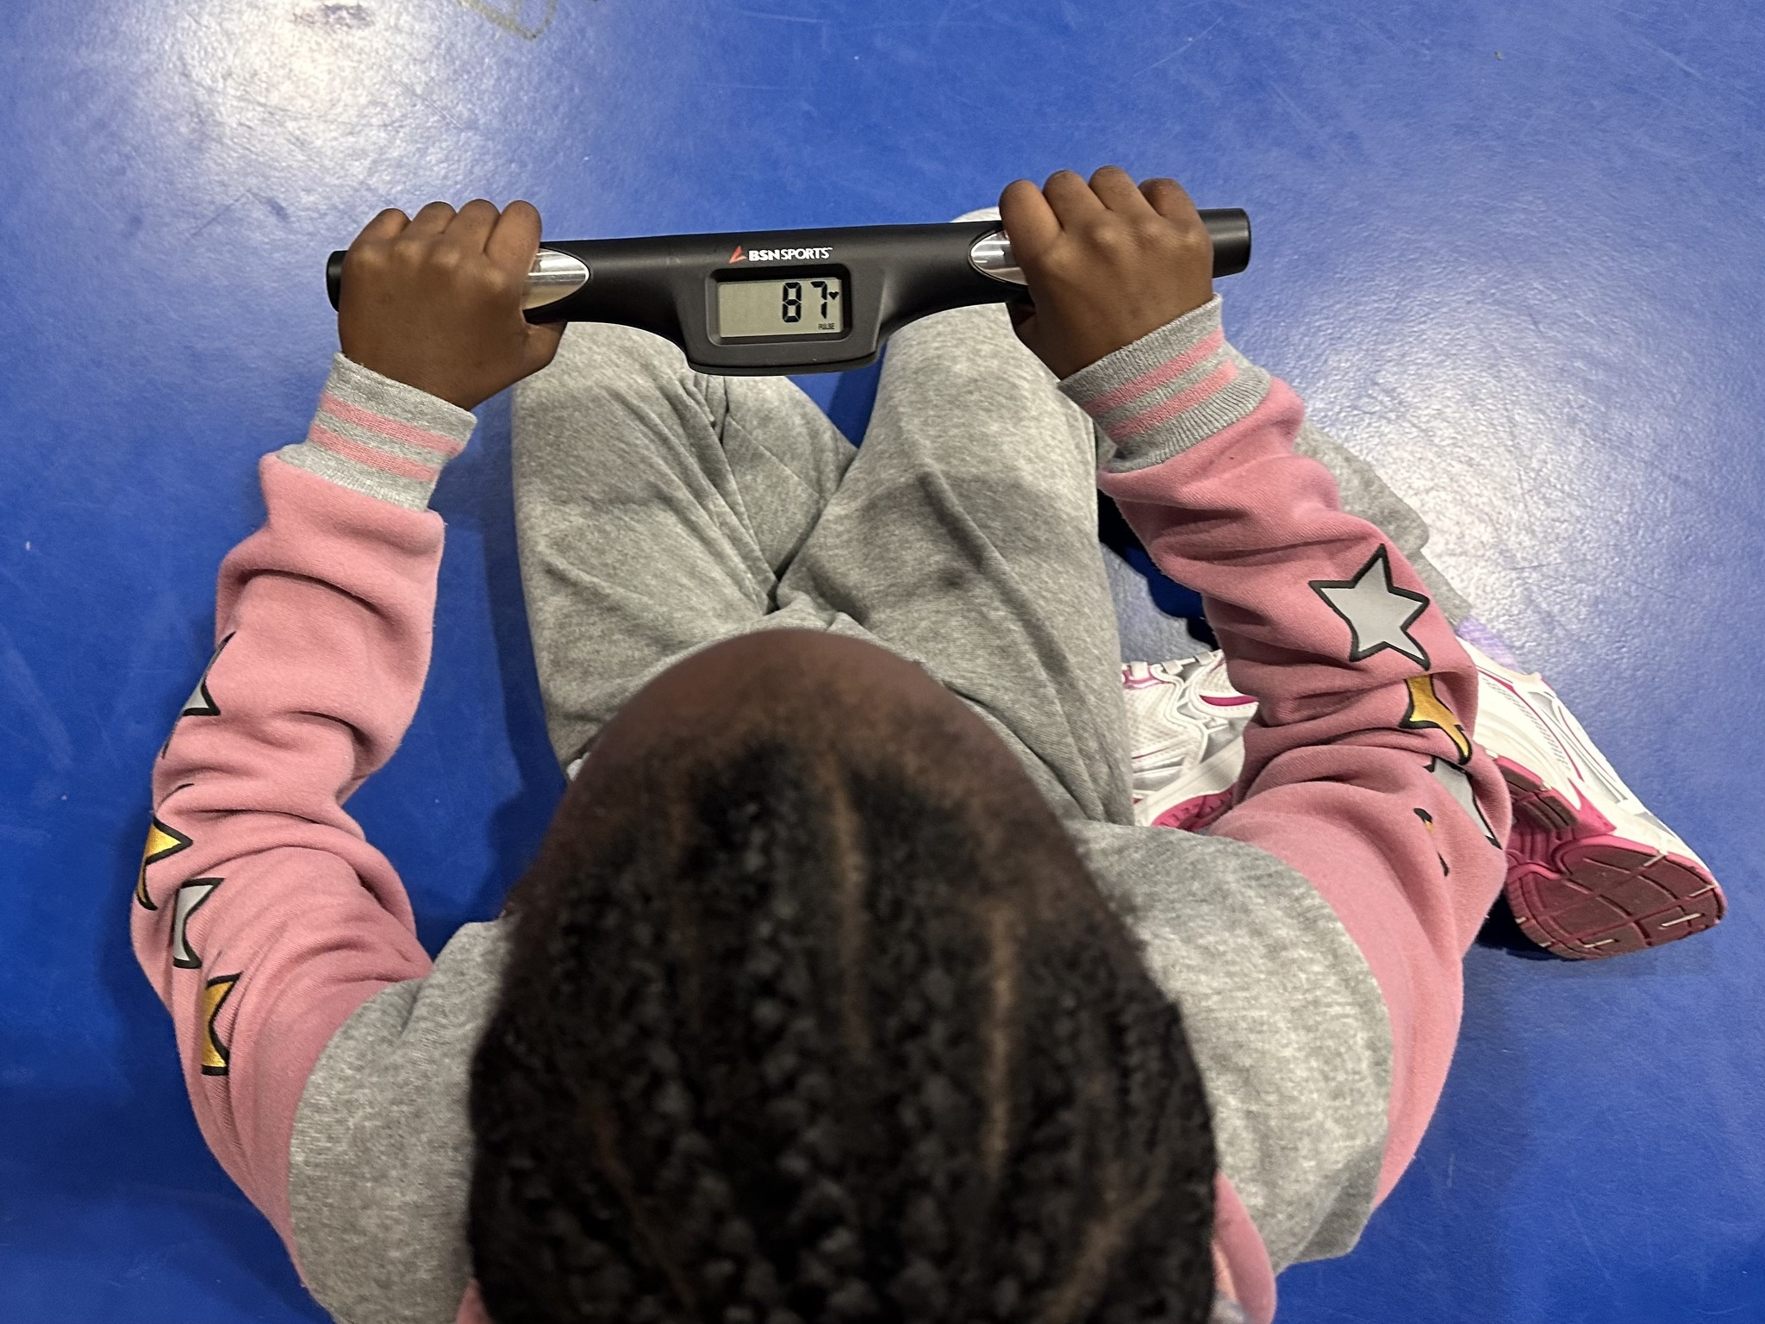
What It Looks Like in a HEAL School
A Complete School Based System
Heart Rate Monitor Technology
Teacher’s Guide
Full-color Handouts & Homeplays
13 Poster Set
Nutrition Game System (see it in action at 12:00 tomorrow)
Inclusion Guide
Game Resource File
HEAL Coordinator
HEAL Hero Recognition Program
Notes:
When a school becomes a HEAL school, they are not receiving a single lesson or one time event. They receive a full system of support.
Each school is equipped with:
Heart rate monitor technology so students can see their own progress in real time and connect effort to results.
A comprehensive Teacher’s Guide that makes implementation clear, structured, and sustainable.
Student handouts and homeplays that extend learning beyond the classroom and into the home.
Visual posters that reinforce key health messages throughout the building.
A nutrition game system that makes learning interactive and engaging.
An Inclusion Guide to ensure students of all ability levels can participate fully.
A complete game resource file so teachers have ready to use materials at their fingertips.
In addition, every school has a designated HEAL Coordinator. This person serves as the on site champion who keeps the program moving, organized, and visible.
We also build leadership and ownership through the HEAL Hero recognition program. Students, schools, and entire systems can be recognized for meaningful changes that promote a healthy lifestyle. This shifts the focus from compliance to celebration. It creates momentum and pride.
So when we talk about 217 schools, we are not talking about a name on a list. We are talking about classrooms equipped, teachers supported, students engaged, and school cultures that begin to change from the inside out.

Slide 9

No Cost to Alabama Schools
How HEAL Is Funded
Alabama Department of Education
Blue Cross and Blue Shield of Alabama
Alabama Power
The HEAL Team Secures Grants & Funding
Schools focus on students.
We handle the fundraising.
Ensuring equitable access for the schools that need it the most.
Notes:
One of the most important things to understand about HEAL is this: there is no cost to Alabama schools.
Schools are not asked to find extra money in already tight budgets. They are not asked to reallocate funds from academics or staffing.
HEAL is funded through strong partnerships with the Alabama Department of Education, Blue Cross and Blue Shield of Alabama, and Alabama Power.
In addition, our team actively pursues grants and private funding to sustain and expand the work.
That means principals and teachers can focus on implementation and student impact, while we focus on securing the resources.
Access matters. Equity matters. And removing the financial barrier allows us to serve schools that need it most.

Slide 10
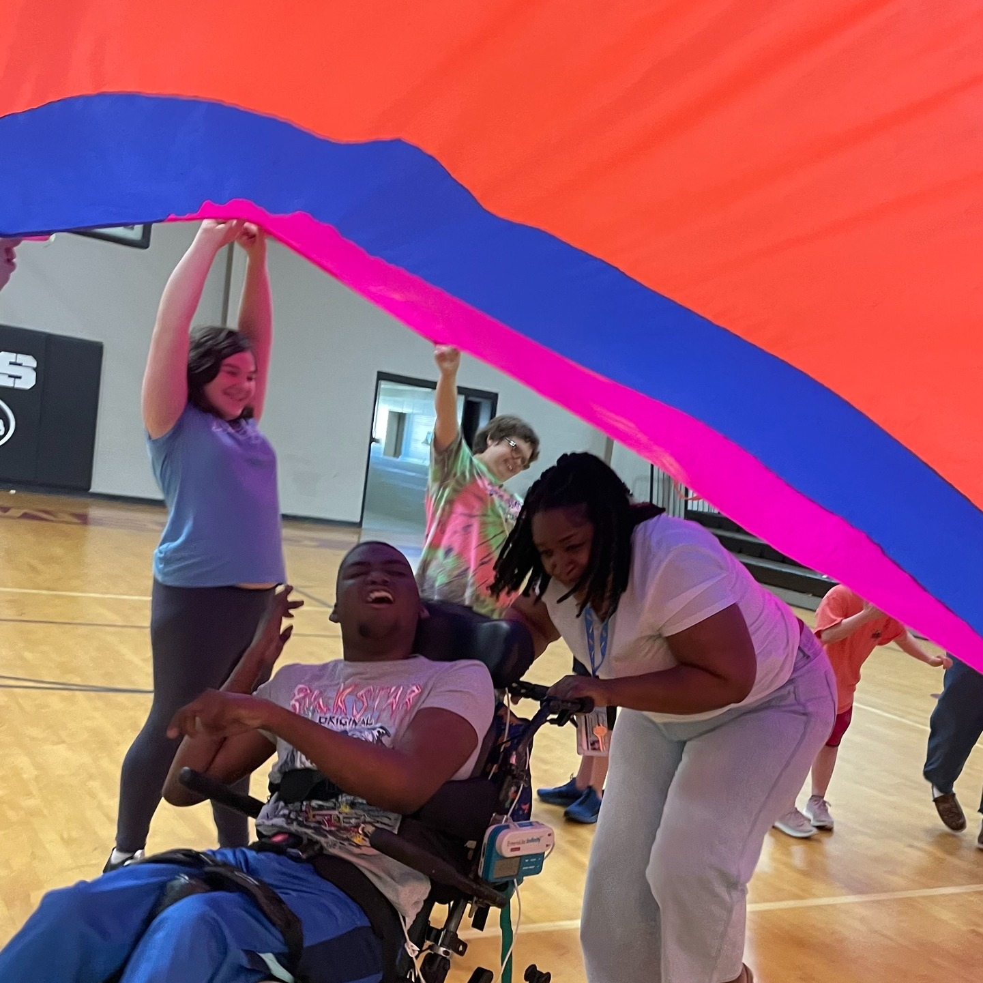
Not an Alabama teacher or school? That’s okay…
Future expansion….
We are open to this opportunity, just not sure what that would look like right now.
Interested? Let’ talk….
In the meantime…
Notes:
If you’re not in Alabama: we’re open to expansion, but we want to do it right — with a model that stays sustainable.
We’re currently in the ‘conversation + partnership’ stage — if there’s interest, we want to talk through what support would look like.
If you’re a state leader, district leader, or grant writer, or a passionate teacher that wants to make it happen, you’re who we need in that conversation.

Slide 11
Our resources that are currently open to everyone
Calendars
Recipes
Blog posts
Classroom Energizers
Learning Videos and Handouts/Homeplays
(Curriculum Levels)
Nutrition Cards*
www.HealUnited.org

Slide 12
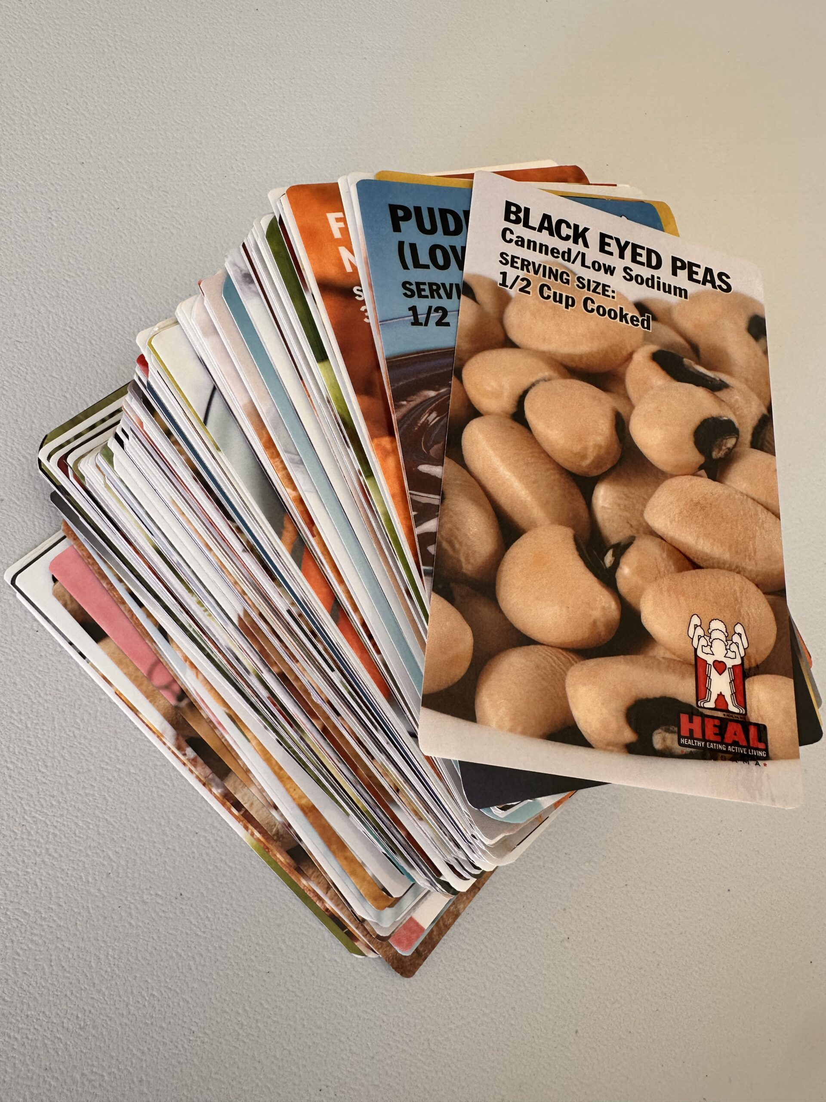
Find your food family
Find someone that has a food that is the same food group as you.
Introduce yourself
Show what food you have
Discuss- What is your biggest challenge in teaching nutrition?
TRADE CARDS

Slide 13
Find your food family
Find someone that has one of the same body benefits as you (look on the back of your nutrition cards)
Introduce yourself
Show what food you have
Discuss- What’s your biggest challenge in helping students build healthy eating + active living habits?
- TRADE CARDS

Slide 14
Find your food family
Find someone who’s food has the same nutritional value as you? (HML)
Introduce yourself
Show what food you have
Discuss- How can you see HEAL United resources used in your program?
- TRADE CARDS

Slide 15
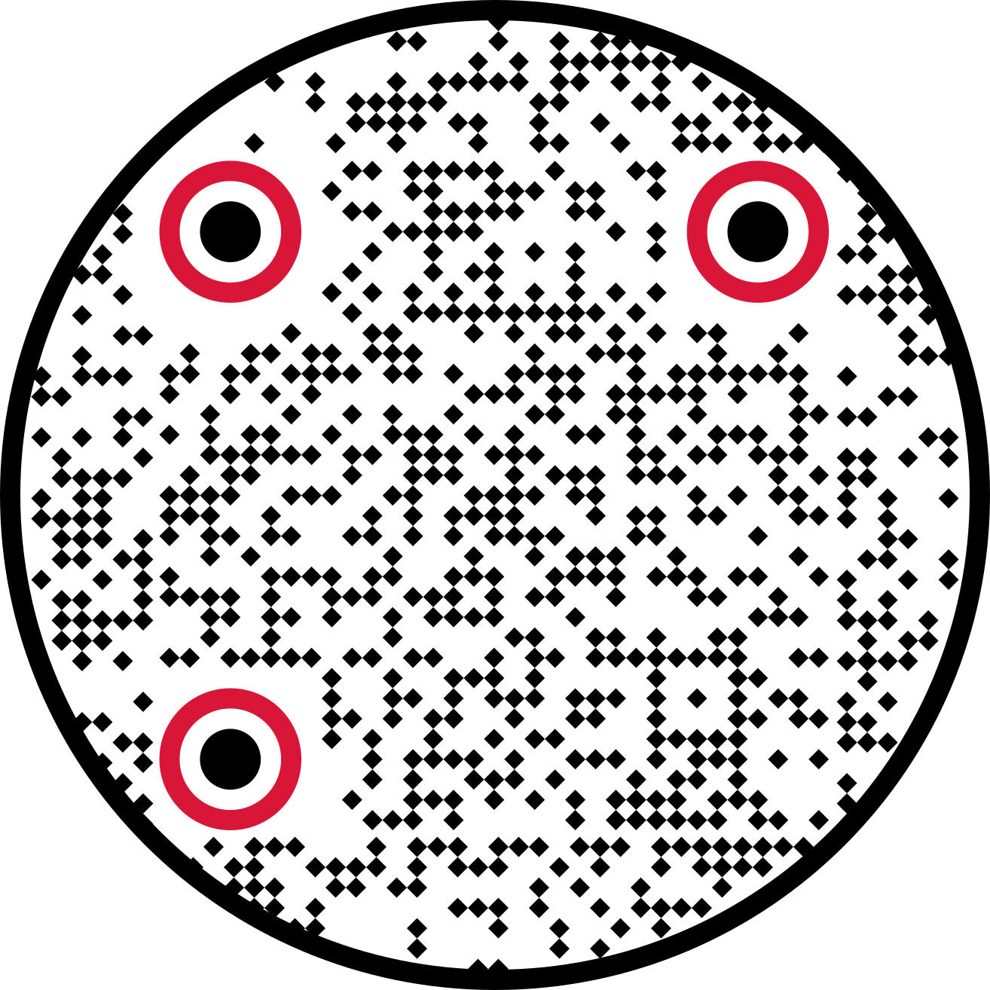
Let’s connect.
Cristina Saunders: Cristina@healunited.org
Ginger Aaron-Brush: Ginger@healunited.org
Follow our socials

